Slide 1
Recurrent Neural Network (RNN)

Slide 2
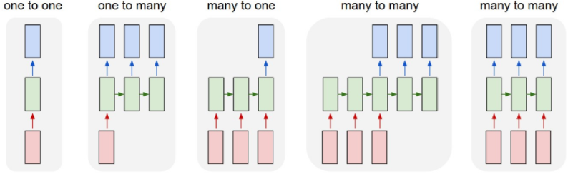
RNN的输入-输出结构
Input vectors
output vectors
RNN's state
processing without RNN
e.g. image captioning
e.g. sentiment analysis
e.g. Machine Translation
e.g. video classification
http://karpathy.github.io/2015/05/21/rnn-effectiveness/
Each rectangle is a vector and arrows represent functions

Slide 3
RNN的输入-输出结构
Input vectors
output vectors
RNN's state
processing without RNN
e.g. image captioning
e.g. sentiment analysis
e.g. Machine Translation
e.g. video classification
http://karpathy.github.io/2015/05/21/rnn-effectiveness/
Each rectangle is a vector and arrows represent functions

Slide 4
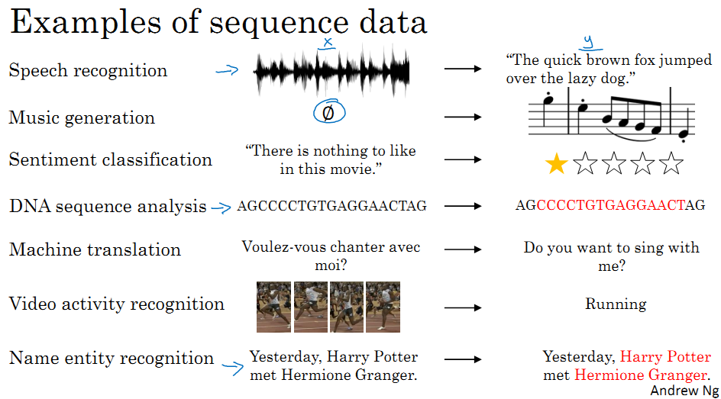

Slide 5

GitHub Project: Awesome Recurrent Neural Networks
A curated list of resources dedicated to recurrent neural networks (closely related to deep learning)
https://github.com/kjw0612/awesome-rnn

Slide 6
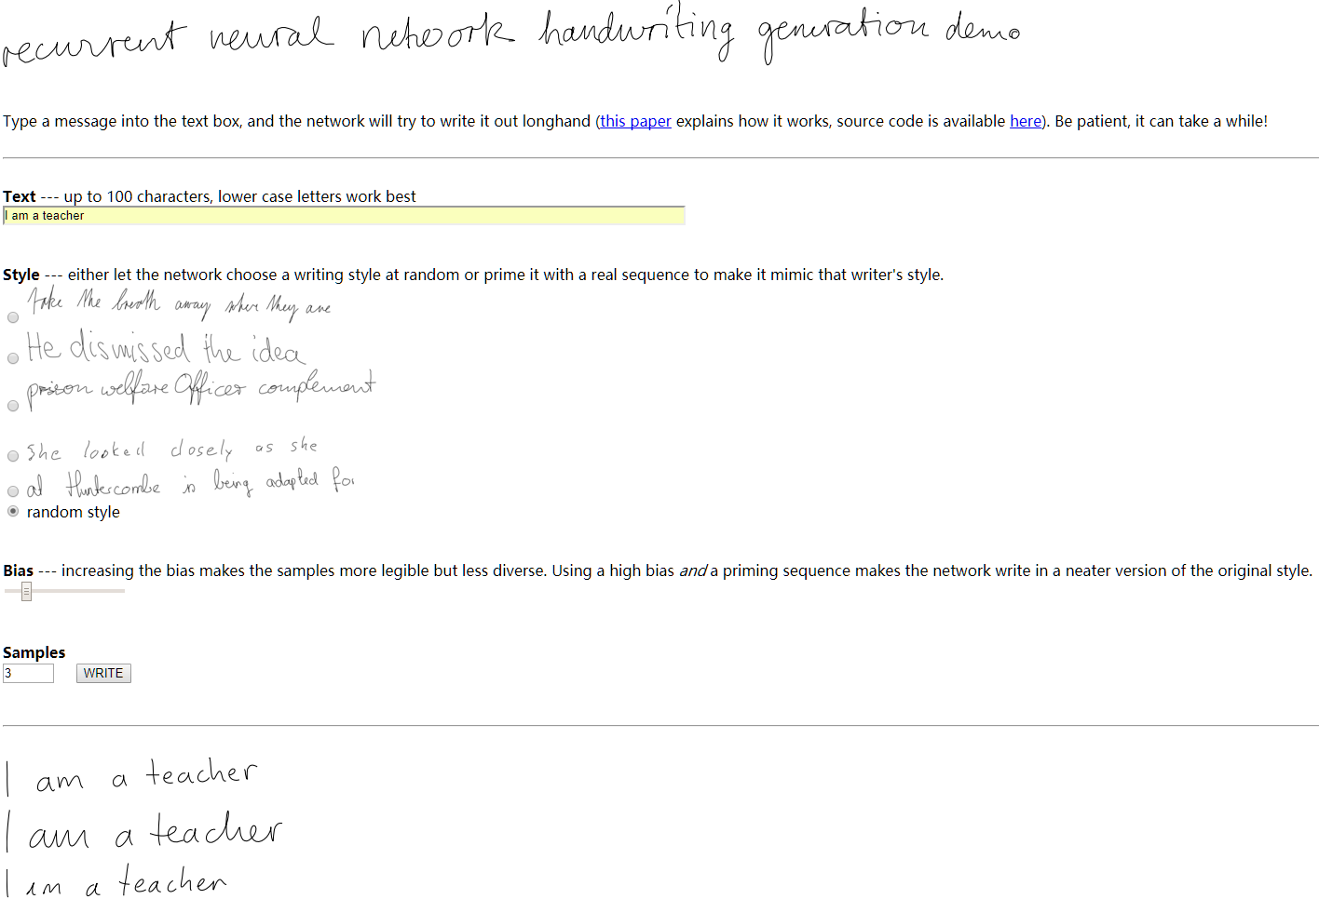
Demo
Alex graves, hand-writing generation [link]

Slide 7

Example Application
Slot Filling
I would like to arrive Suzhou on November 2nd.
Focus on:
Source
Destination
Arrival time
Departure time
ticket booking system
Destination:
Suzhou
Slot
time of arrival:
November 2nd

Slide 8
other
dest
other
time
time
？
arrive Suzhou on November 2nd

Slide 9
Example Application
Solving slot filling by Feedforward network?
Input: a word
(Each word is represented as a vector)
Suzhou

Slide 10
1-of-N encoding
How to represent each word as a vector?
1-of-N Encoding
lexicon = {apple, bag, cat, dog, elephant}
The vector is lexicon size.
apple = [ 1 0 0 0 0]
bag = [ 0 1 0 0 0]
Each dimension corresponds to a word in the lexicon
cat = [ 0 0 1 0 0]
The dimension for the word is 1, and others are 0
dog = [ 0 0 0 1 0]
elephant = [ 0 0 0 0 1]

Slide 11
Beyond 1-of-N encoding
Dimension for “Other”
Word hashing
apple
0
a-a-a
0
bag
0
a-a-b
0
…
…
cat
0
a-p-p
1
dog
0
…
…
…
26 X 26 X 26
elephant
0
p-l-e
1
…
…
p-p-l
1
“other”
1
…
…
w = “apple”
w = “Gandalf”
w = “Sauron”

Slide 12
Example Application
time of departure
dest
Solving slot filling by Feedforward network?
Input: a word
(Each word is represented as a vector)
Output:
Probability distribution that the input word belonging to the slots
Suzhou

Slide 13
Example Application
time of departure
dest
arrive Suzhou on November 2nd
other
dest
other
time
time
Problem?
leave Suzhou on November 2nd
place of departure
Neural network needs memory!
Suzhou

Slide 14
Recurrent Neural Network (RNN)
The output of hidden layer are stored in the memory.
store
Memory can be considered as another input.

Slide 15
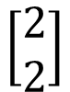
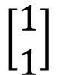
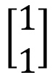
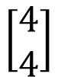
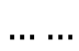
Example
Input sequence:
$$\left[\begin{aligned}1 \\ 1\end{aligned}\right]$$
$$\left[\begin{aligned}1 \\ 1\end{aligned}\right]$$
$$\left[\begin{aligned}2 \\ 2\end{aligned}\right]$$
$$……$$
output sequence:
$$\left[\begin{aligned}4 \\ 4\end{aligned}\right]$$
4
4
store
2
2
given Initial values
0
0
All the weights are “1”, no bias
1
1
All activation functions are linear

Slide 16
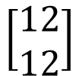
Example
Input sequence:
$$\left[\begin{aligned}1 \\ 1\end{aligned}\right]$$
$$\left[\begin{aligned}1 \\ 1\end{aligned}\right]$$
$$\left[\begin{aligned}2 \\ 2\end{aligned}\right]$$
$$……$$
output sequence:
$$\left[\begin{aligned}4 \\ 4\end{aligned}\right]$$
$$\left[\begin{aligned}12 \\ 12\end{aligned}\right]$$
12
12
store
6
6
2
2
All the weights are “1”, no bias
1
1
All activation functions are linear

Slide 17
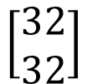
Example
Input sequence:
$$\left[\begin{aligned}1 \\ 1\end{aligned}\right]$$
$$\left[\begin{aligned}1 \\ 1\end{aligned}\right]$$
$$\left[\begin{aligned}2 \\ 2\end{aligned}\right]$$
$$……$$
output sequence:
$$\left[\begin{aligned}4 \\ 4\end{aligned}\right]$$
$$\left[\begin{aligned}12 \\ 12\end{aligned}\right]$$
$$\left[\begin{aligned}32 \\ 32\end{aligned}\right]$$
Changing the sequence order will change the output.
32
32
store
16
16
6
6
All the weights are “1”, no bias
2
2
All activation functions are linear
一层隐藏层
Many to Many

Slide 18
RNN
一层隐藏层
Many to Many
The same network is used again and again.
Probability of “arrive” in each slot
Probability of “Suzhou” in each slot
Probability of “on” in each slot
y¹
y²
y³
store
store
a¹
a²
a³
a¹
a²
x¹
x²
x³
arrive Suzhou on November 2nd

Slide 19
RNN
一层隐藏层
Many to Many
Different
Prob of “leave” in each slot
Prob of “Suzhou” in each slot
Prob of “arrive” in each slot
Prob of “Suzhou” in each slot
y²
……
y²
……
y¹
y¹
store
store
a¹
a²
a¹
a²
a¹
……
a¹
……
x¹
x²
……
x¹
x²
……
leave
Suzhou
arrive
Suzhou
The values stored in the memory is different.

Slide 20
Of course it can be deep …
y^{t}
y^{t+1}
y^{t+2}
……
……
……
……
……
……
……
……
……
x^{t}
x^{t+1}
x^{t+2}
多层隐藏层

Slide 21
Elman Network & Jordan Network
Elman Network
Jordan Network
y^{t}
y^{t+1}
y^{t}
y^{t+1}
W^{h}
Wº
Wº
Wº
Wº
……
……
……
……
W^{h}
W^{i}
W^{i}
W^{i}
W^{i}
x^{t}
x^{t+1}
x^{t}
x^{t+1}

Slide 22
Bidirectional RNN
……
x^{t}
x^{t+1}
x^{t+2}
……
y^{t}
y^{t+1}
y^{t+2}
……
……
x^{t}
x^{t+1}
x^{t+2}

Slide 23
Long Short-term Memory (LSTM)
Other part of the network
Special Neuron:
4 inputs,
1 output
Signal control the output gate
Output Gate
(Other part of the network)
Memory
Cell
Forget Gate
Signal control the forget gate
(Other part of the network)
Signal control the input gate
Input Gate
LSTM
(Other part of the network)
LSTM是特殊的神经元
Other part of the network

Slide 24
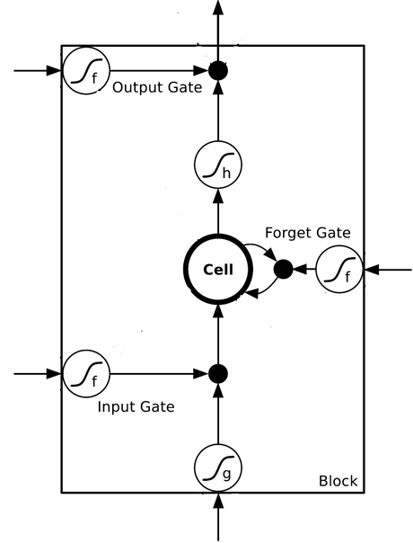
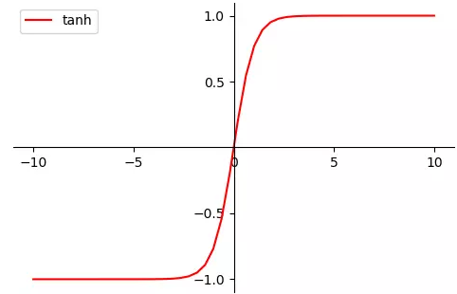
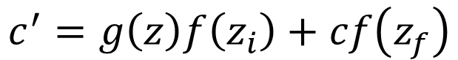
$$a$$
$$=h\left(c^{′}\right)f\left(z_{o}\right)$$
$$z_{o}$$
multiply
Activation function f is usually a sigmoid function
$$f\left(z_{o}\right)$$
$$h\left(c^{′}\right)$$
Between 0 and 1
Mimic(模仿) open and close gate
$$c$$
$$f\left(z_{f}\right)$$
c
$$c^{′}$$
$$z_{f}$$
$$cf\left(z_{f}\right)$$
$$c^{′}=g\left(z\right)f\left(z_{i}\right)+cf\left(z_{f}\right)$$
$$f\left(z_{i}\right)$$
$$g\left(z\right)f\left(z_{i}\right)$$
$$z_{i}$$
multiply
Function g and function h: tanh
$$g\left(z\right)$$
$$z$$

Slide 25
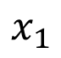
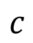
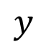
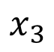
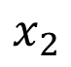
LSTM - Example
$$c$$
0
0
3
3
7
7
7
0
6
$$x_{1}$$
1
0
0
3
1
0
2
0
0
4
1
0
2
0
0
1
0
1
3
-1
0
6
1
0
1
0
1
$$x_{2}$$
$$x_{3}$$
0
0
$$y$$
0
0
0
0
0
7
0
0
6
When x₂ = 1, add the numbers of x₁ into the memory
When x₂ = 0, don’t update the memory
When x₂ = -1, reset the memory to zero
When x₃ = 1, output the number in the memory.

Slide 26
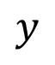
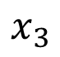
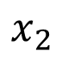
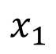
x₁
0
y
$$y$$
0
0
0
7
0
x₂
0
+
x₃
100
0
x₁
1
-10
100
0
0
+
x₂
x₁
f(-10) ≈ 0
f(10+) ≈ 1
0
x₃
x₂
100
+
10
1
x₃
0
1
-10
+
$$x_{1}$$
3
1
0
4
1
0
2
0
0
1
0
1
3
-1
0
1
0
0
0
$$x_{2}$$
x₁
x₂
x₃
1
$$x_{3}$$

Slide 27
3
0
≈0
y
$$y$$
0
0
0
7
0
1
0
+
≈0
3
0
100
0
3
1
-10
0
100
0
3
+
1
3
≈1
0
0
100
≈1
3
1
+
10
1
3
0
0
1
-10
+
$$x_{1}$$
3
1
0
4
1
0
2
0
0
1
0
1
3
-1
0
1
0
0
0
$$x_{2}$$
3
1
0
1
$$x_{3}$$

Slide 28
4
0
≈0
y
$$y$$
0
0
0
7
0
1
0
+
≈0
7
0
100
0
4
1
-10
7
100
0
3
+
1
4
≈1
0
0
100
≈1
4
1
+
10
1
4
0
0
1
-10
+
$$x_{1}$$
3
1
0
4
1
0
2
0
0
1
0
1
3
-1
0
1
0
0
0
$$x_{2}$$
4
1
0
1
$$x_{3}$$

Slide 29
2
0
≈0
y
$$y$$
0
0
0
7
0
0
0
+
≈0
7
0
100
0
2
1
-10
7
100
0
+
0
2
≈1
0
0
100
≈0
0
0
+
10
1
2
0
0
1
-10
+
$$x_{1}$$
3
1
0
4
1
0
2
0
0
1
0
1
3
-1
0
1
0
0
0
$$x_{2}$$
2
0
0
1
$$x_{3}$$

Slide 30
1
0
≈7
y
$$y$$
0
0
0
7
0
0
0
+
≈1
7
1
100
0
1
1
-10
7
100
0
+
0
1
≈1
0
1
100
≈0
0
0
+
10
1
1
1
0
1
-10
+
$$x_{1}$$
3
1
0
4
1
0
2
0
0
1
0
1
3
-1
0
1
0
0
0
$$x_{2}$$
1
0
1
1
$$x_{3}$$

Slide 31
3
0
≈0
y
$$y$$
0
0
0
7
0
-1
0
+
≈0
0
0
100
0
3
1
-10
0
100
0
7
+
-1
3
≈0
0
0
100
≈0
0
-1
+
10
1
3
0
0
1
-10
+
$$x_{1}$$
3
1
0
4
1
0
2
0
0
1
0
1
3
-1
0
1
0
0
0
$$x_{2}$$
3
-1
0
1
$$x_{3}$$

Slide 32
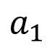
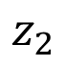
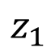
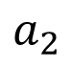
Original Network:
Simply replace the neurons with LSTM
……
……
$$a_{1}$$
$$a_{2}$$
$$z_{1}$$
$$z_{2}$$
x₁
x₂
Input

Slide 33
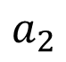
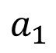
$$a_{1}$$
$$a_{2}$$
+
+
+
+
+
+
+
+
4 times of parameters
x₁
x₂
Input
一层隐藏层中的2个LSTM神经元

Slide 34
LSTM
c^{t-1}
……
vector
z^{f}
z^{i}
z
zº
4 vectors
x^{t}
一层隐藏层中有更多LSTM神经元

Slide 35

LSTM
y^{t}
zº
c^{t-1}
$$×$$
$$＋$$
$$×$$
z^{f}
$$×$$
z^{i}
z^{f}
z^{i}
z
zº
x^{t}
z

Slide 36
LSTM
Extension: “peephole”
y^{t}
y^{t+1}
c^{t-1}
c^{t}
c^{t+1}
$$×$$
$$＋$$
$$×$$
$$×$$
$$＋$$
$$×$$
$$×$$
$$×$$
z^{f}
z^{i}
z
zº
z^{f}
z^{i}
z
zº
c^{t-1}
h^{t-1}
x^{t}
c^{t}
h^{t}
x^{t+1}
一层隐藏层

Slide 37
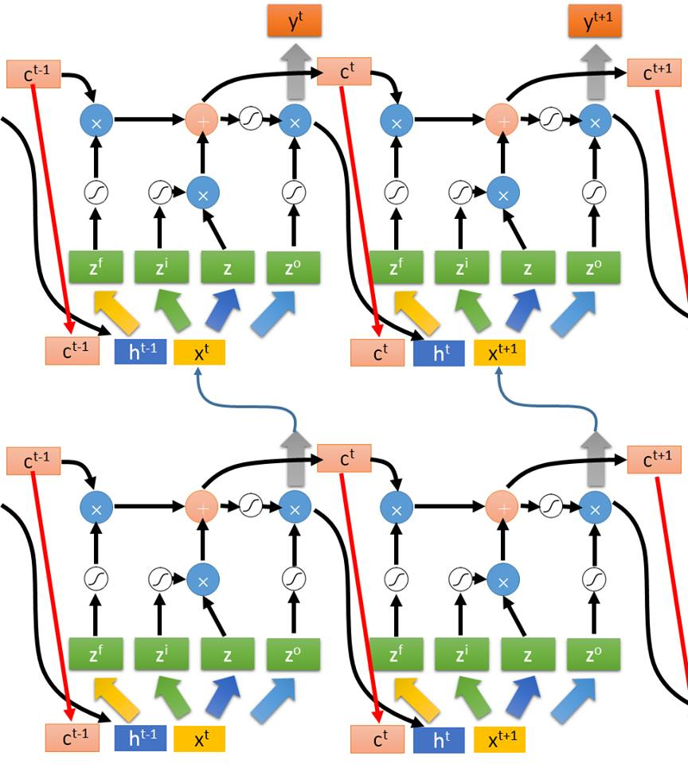
Multiple-layer
LSTM
Don’t worry if you cannot understand this. Keras can handle it.
Keras supports
“LSTM”, “GRU”, “SimpleRNN” layers
This is quite standard now.
多层隐藏层；观察每个隐藏中的某一个LSTM

Slide 38
Learning Target
other
dest
other
0
…
1
…
0
…
…
…
…
0
1
0
0
1
0
y¹
y²
y³
copy
copy
a¹
a²
a³
a¹
a²
W^{i}
x¹
x²
x³
Training
Sentences:
arrive Suzhou on November 2nd
other
dest
other
time
time

Slide 39
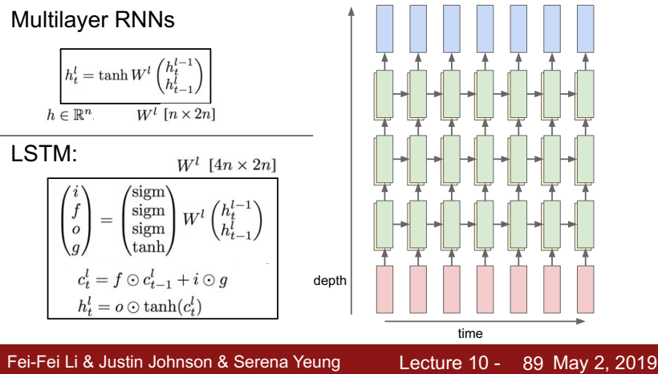

Slide 40
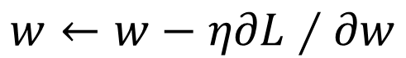

Learning
Backpropagation through time (BPTT)
copy
$$w$$
$$w←w−η∂L∕∂w$$

Slide 41
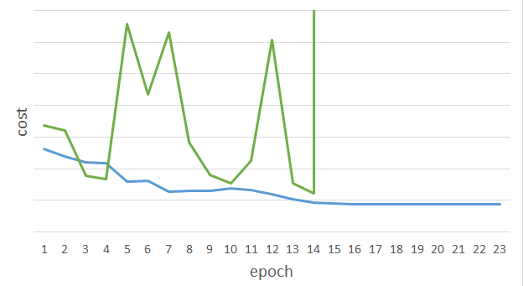
Unfortunately ……
RNN-based network is not always easy to learn
Real experiments on Language modeling
sometimes
Total Loss
Lucky
Epoch

Slide 42
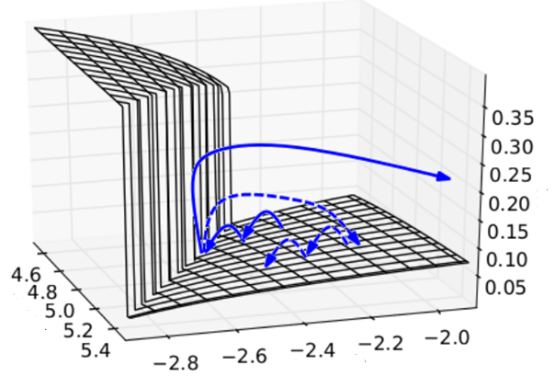

The error surface is rough.
The error surface is either very flat or very steep.
Clipping
Cost
Total Loss
w₂
w₁
[Razvan Pascanu, ICML’13]

Slide 43
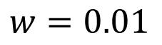
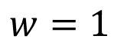
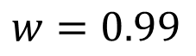
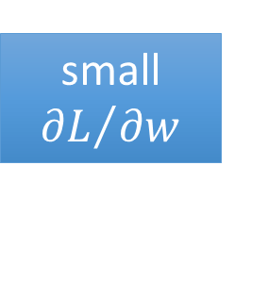
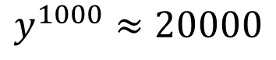
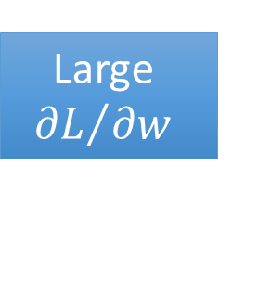
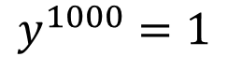
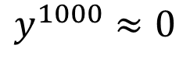
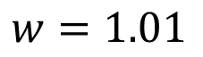
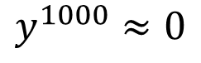
Why?
$$w=1$$
$$y^{1000}=1$$
Large
$${∂L}/{∂w}$$
Small Learning rate?
$$w=1.01$$
$$y^{1000}≈20000$$
$$w=0.99$$
$$y^{1000}≈0$$
small ${∂L}/{∂w}$
Large Learning rate?
$$w=0.01$$
$$y^{1000}≈0$$
=w⁹⁹⁹
y¹
y²
y³
y¹⁰⁰⁰
Toy Example
1
1
1
1
……
w
w
w
1
0
0
0

Slide 44
Helpful Techniques
Long Short-term Memory (LSTM)
Can deal with gradient vanishing (not gradient explode)
Memory and input are added
The influence never disappears unless forget gate is closed
No Gradient vanishing
add
(If forget gate is opened.)
Gated Recurrent Unit (GRU):
simpler than LSTM
[Cho, EMNLP’14]

Slide 45
More Applications ……
Probability of “arrive” in each slot
Probability of “Suzhou” in each slot
Probability of “on” in each slot
y¹
y²
y³
Input and output are both sequences with the same length
store
store
a¹
a²
a³
a¹
a²
RNN can do more than that!
x¹
x²
x³
arrive Suzhou on November 2nd

Slide 47
One to Many
Poem generation
Music generation
Character-level Language Model
Image Captioning

Slide 48
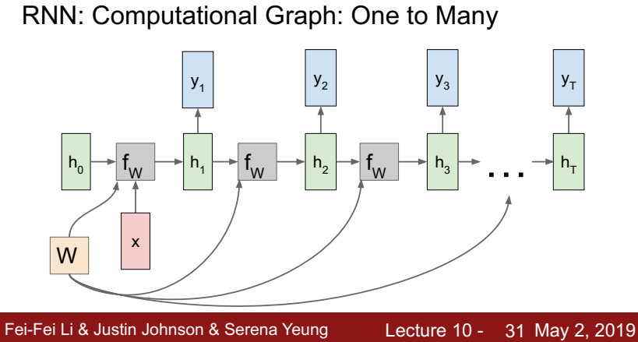

Slide 49
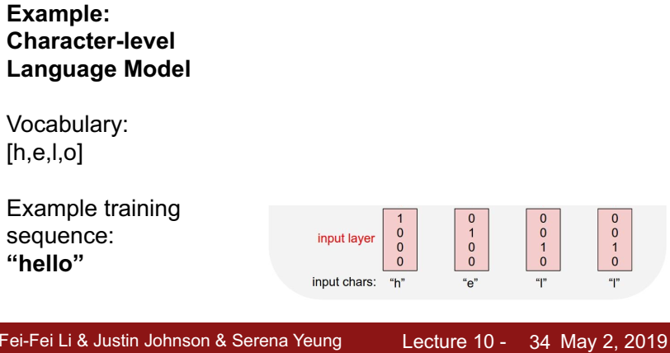

Slide 50
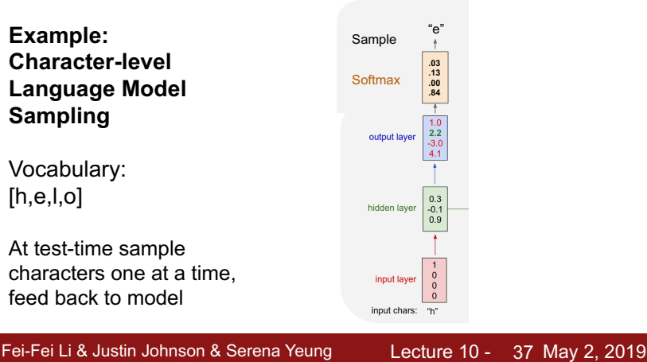

Slide 51
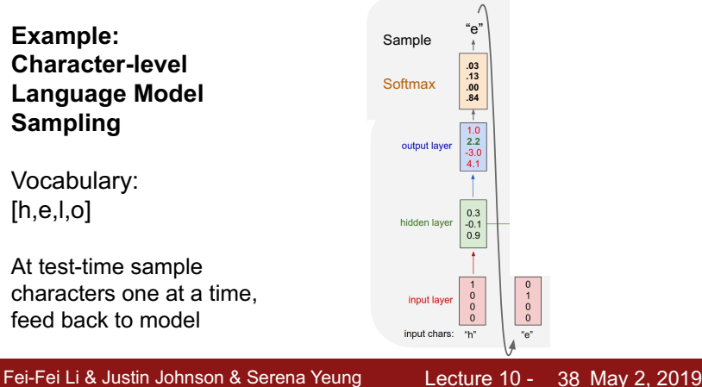

Slide 52
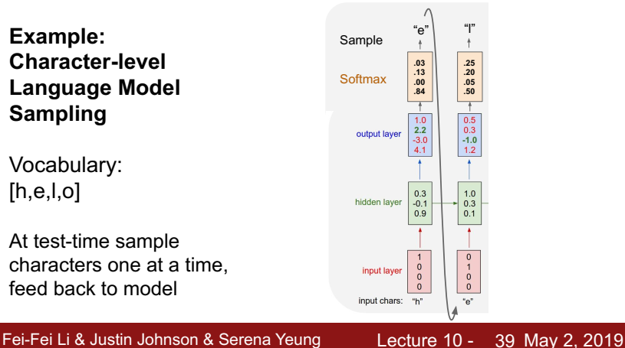

Slide 53
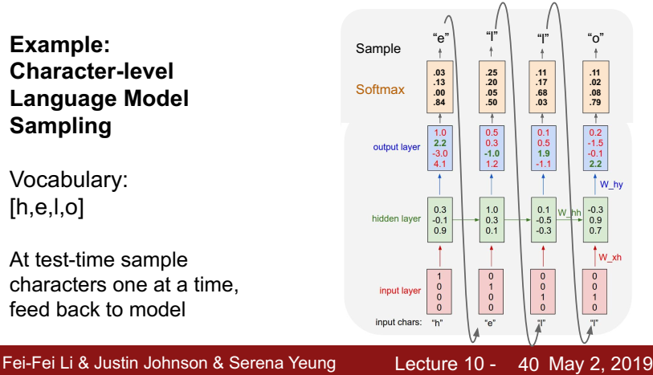

Slide 54
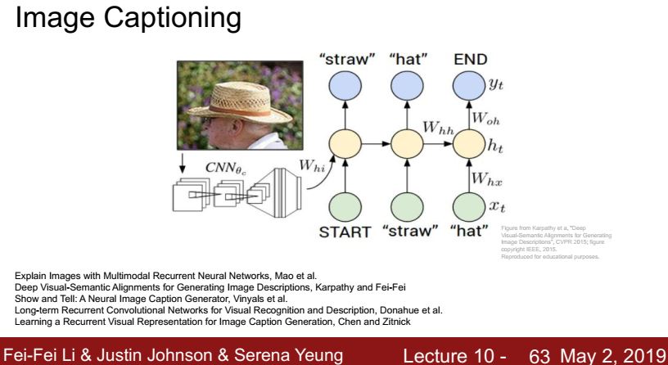

Slide 55


Slide 56


Slide 57


Slide 58


Slide 59


Slide 60


Slide 61


Slide 62


Slide 63


Slide 64


Slide 65


Slide 66


Slide 67


Slide 68
Many to one
Input is a vector sequence, but output is only one vector
Sentiment Analysis
超赞
好赞
看了这部电影觉得很高兴…….
这部电影太糟了
…….
这部电影很棒 …….
赞
逊
Positive (赞)
Negative (逊)
Positive (赞)
超逊
……
我
觉
得
……
太
糟
了

Slide 69

Many to Many (Output is shorter)
Both input and output are both sequences, but the output is shorter.
E.g. Speech Recognition
Output:
“你好”
(character sequence)
Problem?
Trimming
Why can’t it be “你好好”
好
好
好
好
好
^{你}
^{你}
^{你}
(vector
sequence)
Input:

Slide 70
Many to Many (Output is shorter)
Both input and output are both sequences, but the output is shorter.
Connectionist Temporal Classification (CTC) [Alex Graves, ICML’06][Alex Graves, ICML’14][Haşim Sak, Interspeech’15][Jie Li, Interspeech’15][Andrew Senior, ASRU’15]
“你好”
Add an extra symbol “φ” representing “null”
“你好好”
你
φ
φ
好
φ
φ
φ
φ
你
φ
φ
好
φ
好
φ
φ

Slide 71
Many to Many (Output is shorter)
CTC: Training
你
φ
好
φ
φ
φ
Acoustic
Features:
你
φ
φ
好
φ
φ
Label:
你
好
All possible alignments are considered as correct.
你
φ
φ
φ
好
φ
……

Slide 72

Many to Many (Output is shorter)
CTC: example
HIS FRIEND’S
φ
φ
φ
φ
φ
φ
φ
φ
φ
φ
φ
φ
φ
φ
φ
φ
φ
Graves, Alex, and Navdeep Jaitly. "Towards end-to-end speech recognition with recurrent neural networks." Proceedings of the 31st International Conference on Machine Learning (ICML-14). 2014.

Slide 73
Many to Many (No Limitation)
Both input and output are both sequences with different lengths. → Sequence to sequence learning
E.g. Machine Translation (machine learning→机器学习)
Containing all information about input sequence
machine
learning

Slide 74
Many to Many (No Limitation)
Both input and output are both sequences with different lengths. → Sequence to sequence learning
E.g. Machine Translation (machine learning→机器学习)
机
器
学
习
惯
性
……
……
machine
learning
Don’t know when to stop

Slide 75
Many to Many (No Limitation)
Both input and output are both sequences with different lengths. → Sequence to sequence learning
E.g. Machine Translation (machine learning→机器学习)
机
器
学
习
===
Encoder
Decoder
machine
learning
Add a symbol “===“ (断)
[Ilya Sutskever, NIPS’14][Dzmitry Bahdanau, arXiv’15]

Slide 76
Thanks!

